Slide 1
AIML Project
Car Price Prediction Team Members 2210992344 : Shreya Thakur 2210992348 : Shreyashi Singh 2210992353 : Shriya Seth 2210992354 : Shruti

Slide 2
CONTENT
Problem Statement
Objective
Tools Used
Data Summary
Exploratory Data Analysis
Challenges
Recommendations
Conclusions

Slide 3
PROBLEM STATEMENT
A Chinese automobile company Geely Auto aspires to enter the US market by setting up their manufacturing unit there and producing cars locally to give competition to their US and European counterparts.
They have contracted an automobile consulting company to understand the factors on which the pricing of cars depends. Specifically, they want to understand the factors affecting the pricing of cars in the American market, since those may be very different from the Chinese market. The company wants to know:
Which variables are significant in predicting the price of a car How well those variables describe the price of a car Based on various market surveys, the consulting firm has gathered a large data set of different types of cars across the America market.

Slide 4


Slide 5
OBJECTIVE
The objective of the project is to perform an exploratory data analysis, data pre-processing, data cleaning and at the end, apply different Data Visualization techniques to get the meaningful insight from the given data. This project aims applying some amazing Python Libraries like as matplotlib , seaborn which will give a boost to our visual understanding of the data.

Slide 6
Tools Used
Google colab is used as IDE.
Pandas and NumPy are used for Data Manipulation & Pre-processing and Mathematical functions respectively.
Exploratory data analysis is automated by data prep.
For visualization of the plots, Matplotlib, Seaborn are used.
GitHub is used as version control system

Slide 7

DATA SUMMARY
Categorical Data
1.FuelType
2.DoorNumber
3.Fuelsystem
4.EngineType
Numerical Data
1.DoorNumber
2.CarLength
3.Price
4.HorsePower
5.carLength
6.CarWidth
7.CarHeight
8.CylinderNumber
Unique Data
1.Car_id

Slide 8
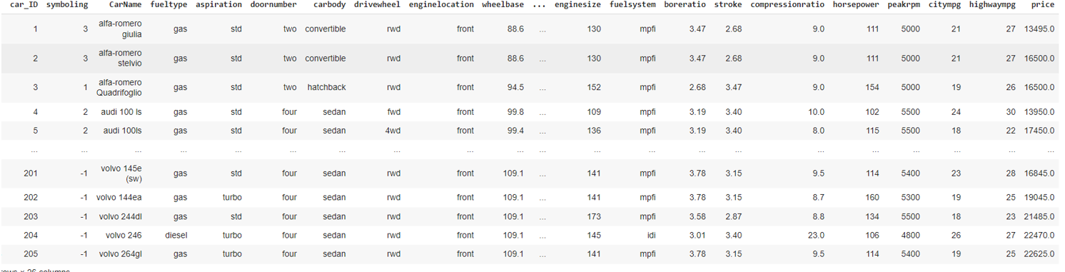
DATA SUMMARY
This is the Car price prediction dataset. In the below table it shows the top and bottom 5 rows respectively

Slide 9
FEATURES DESCRIPTION
id: Unique for each Car
CarName: Name of the car
FuelType : type of fuel in car
HorsePower: power produced by engine
DoorNumber: Number of doors a car have
EngineSize: Size of the engine
CylinderNumber : Number of engine that a car have

Slide 10
FEATURES DESCRIPTION
Aspiration: the cause of the air's presence, making it essential for your engine
Price: It provides the price of each listed car.
Stroke: The stroke is the depth of the cylinder
Highwaympg : the average a car will get while driving on an open stretch of road without stopping or starting, typically at a higher speed.
WheelBase: the distance between the centres of the front and rear wheels

Slide 11
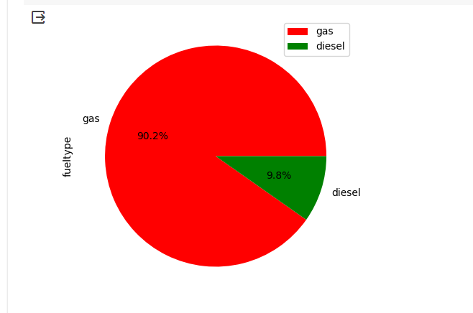
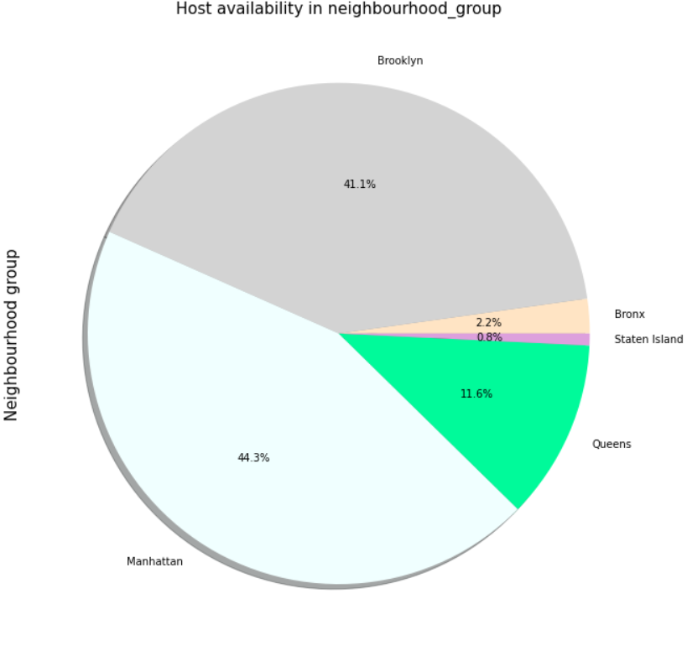
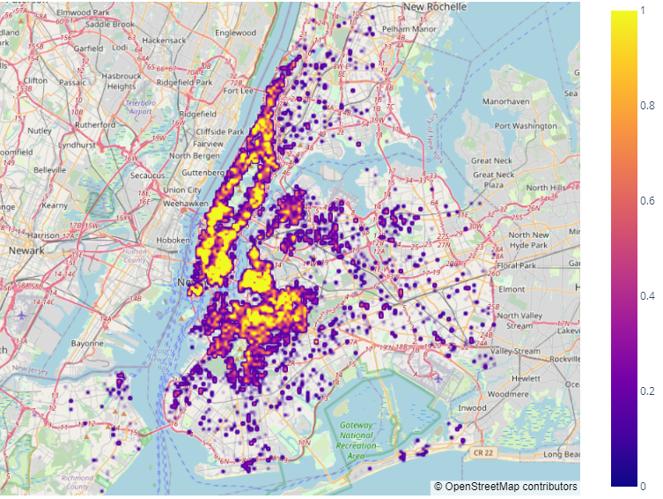
Analysis of the Distribution of cars based on fuel type
Below plot is pie chart shows the percentage of fuel type of cars.
This chart shows that most of the cars have gas fuel.

Slide 12
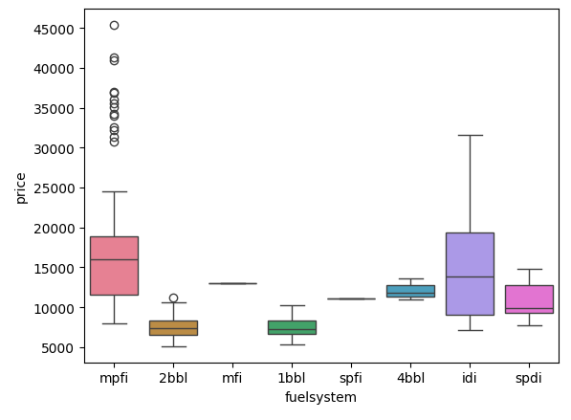
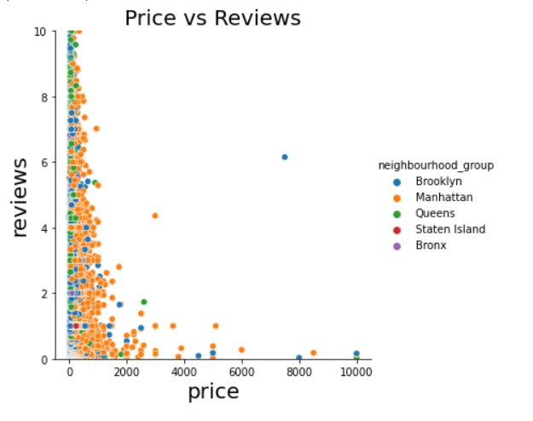
Analysis of the Distribution of cars based on fuel system
Box plot is a great chart to show the outliers. In this chart we have found the effect of fuel system on prices of the car.
This chart shows the change in the price of the car with different fuel systems. Here we can see that the price range of car having idi fuel system is high

Slide 13
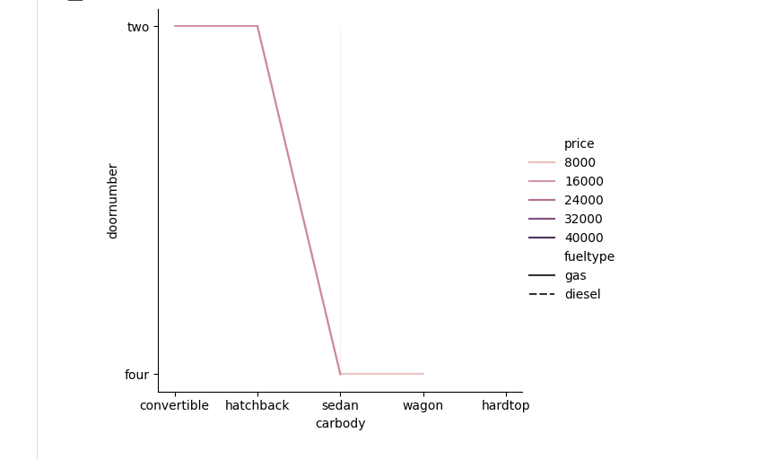
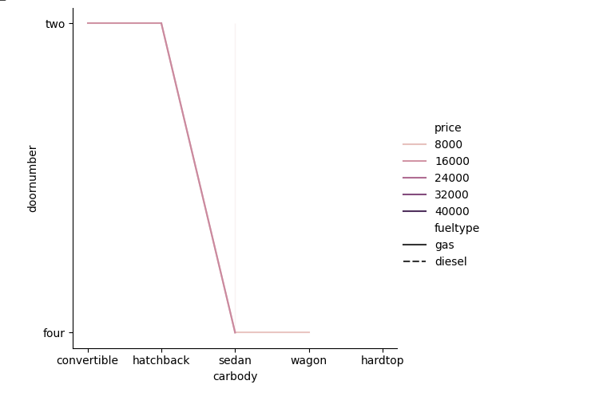
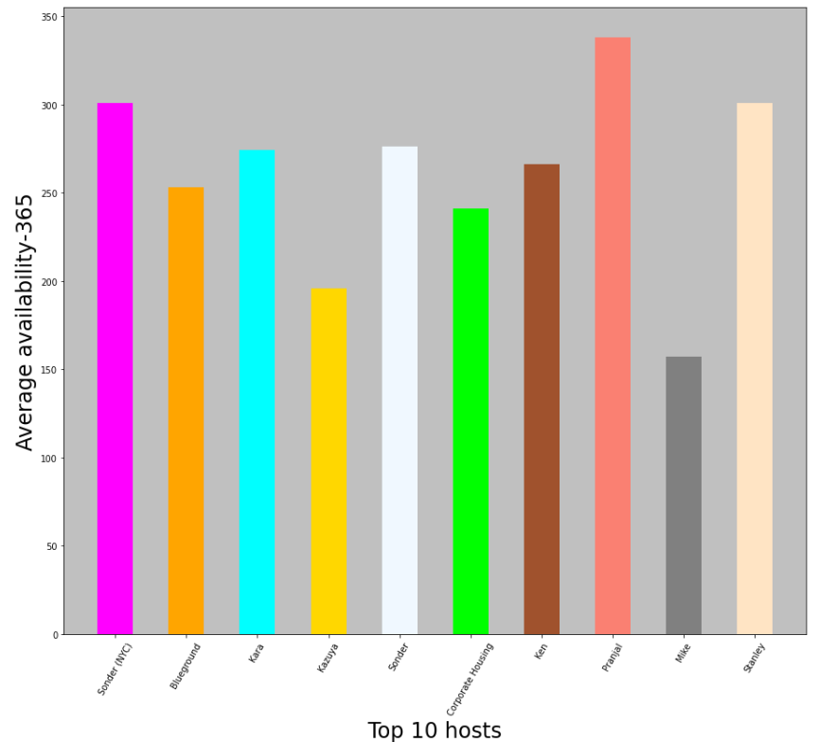
Visualize the relationship between two variables
A scatter plot (created using sns. relplot) is chosen to visualize the relationship between two variables.
we can infer whether there’s any correlation between car body type, door count, and price.
'Sonder (NYC)'
'Blueground'
'Kara'
'Kazuya'
'Sonder'
'Corporate Housing'
'Ken'
'Pranjal'
'Mike'
'Stanley'

Slide 14
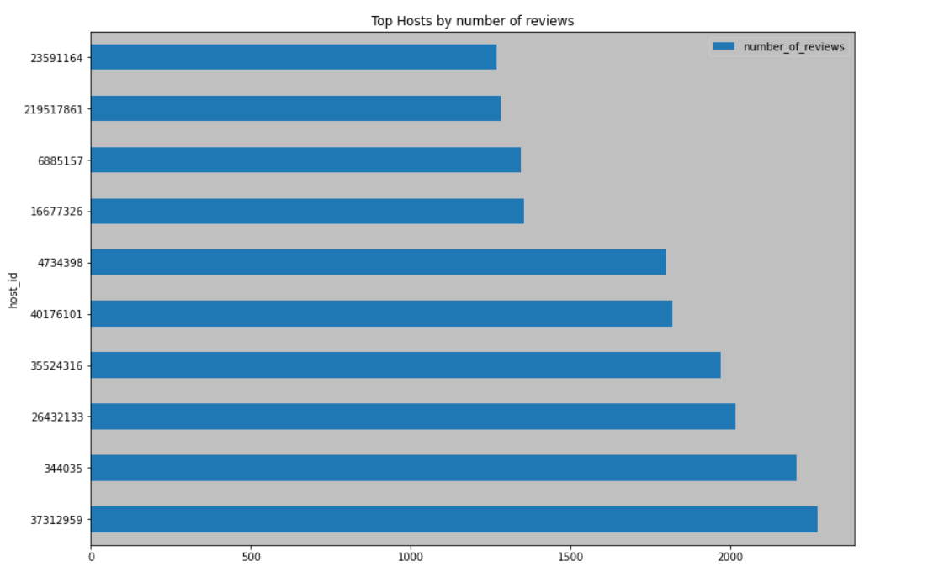
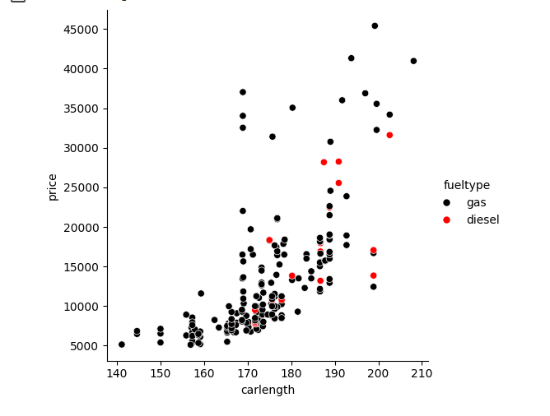
Visualize the relationship between two variables
A scatter plot is appropriate here as it allows visualizing the relationship between two variables, car length and price. The hue parameter is set to 'fuel type' for categorical differentiation.

Slide 15
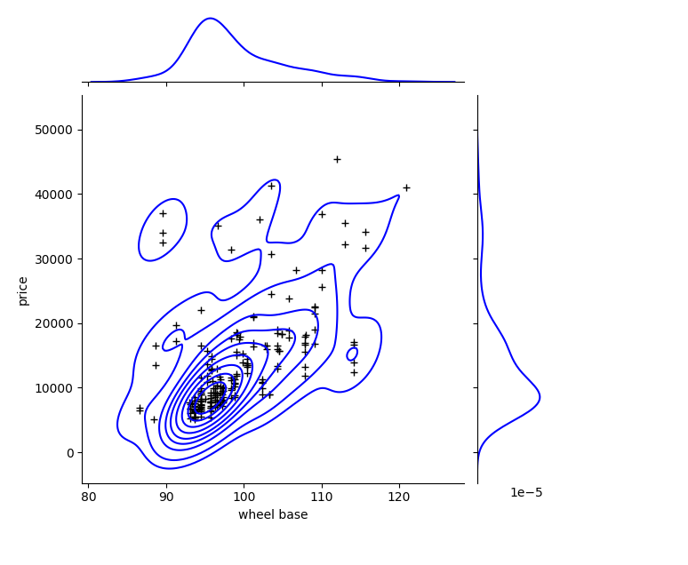
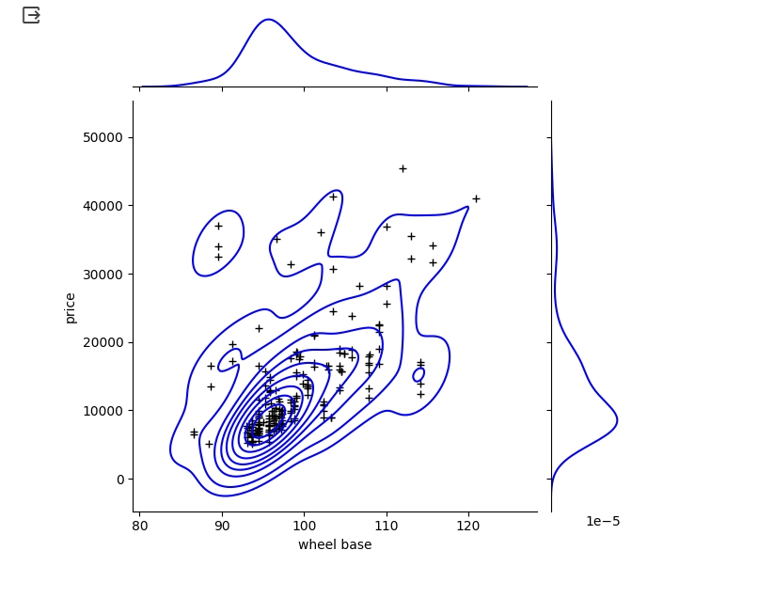
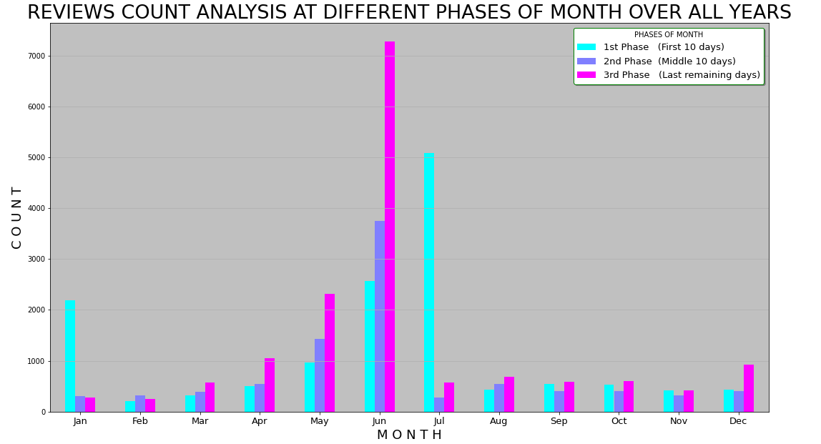
Visualize the relationship between two variables
The joint plot is the best plot to show the relationship between two variables separately as well as collectively on each other. Thus, using this chart we have shown the relation between Wheelbase and price.

Slide 16
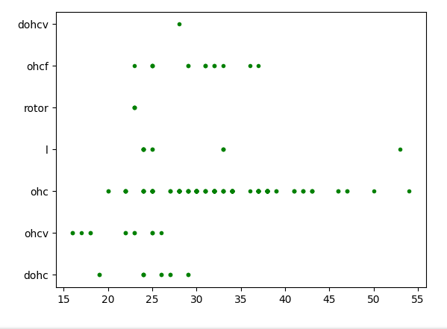
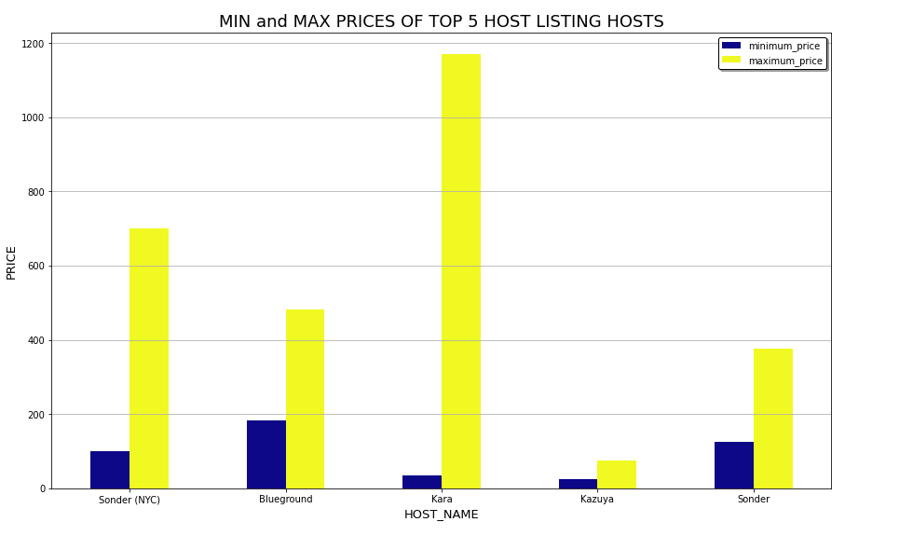
Visualize the relationship between two variables
A scatter plot is a suitable choice to visualize the relationship between two continuous variables, highway mpg (highway miles per gallon) and engine type (type of engine)
We can see how different engine types correspond to varying highway miles per gallon.
This dependency have a significant impact on the sales of the car since the cars are best tested and evaluated on highways mileage.

Slide 17
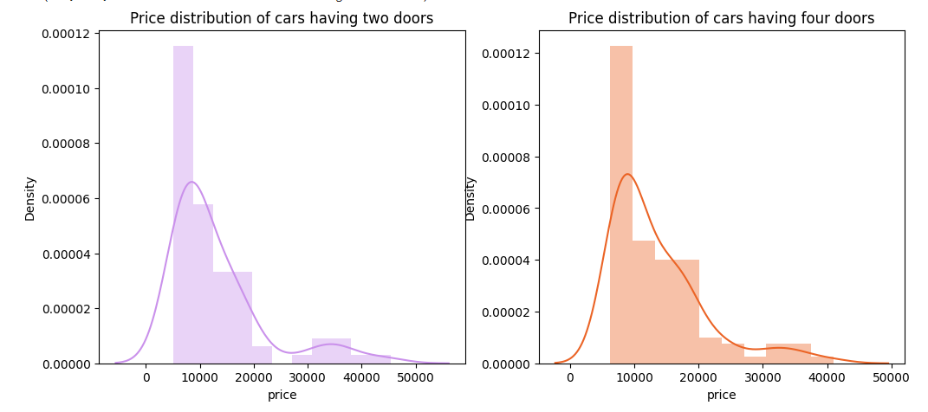
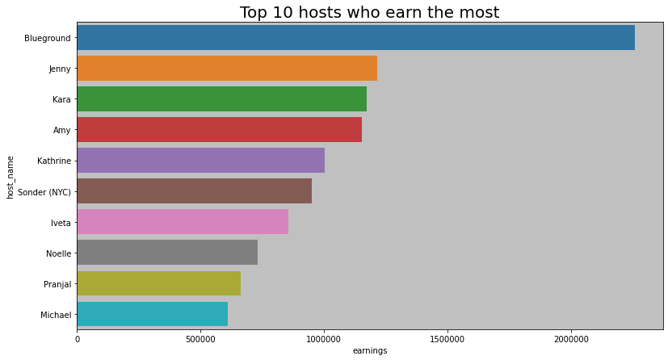
Price distribution of cars
Here, based on the distribution of the prices of the cars for the different number of doors.

Slide 18
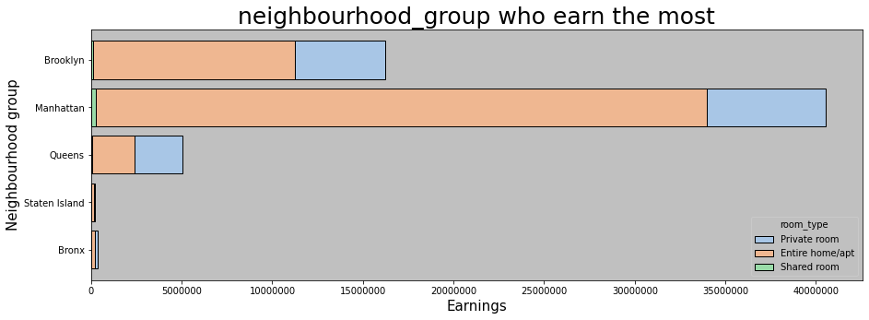
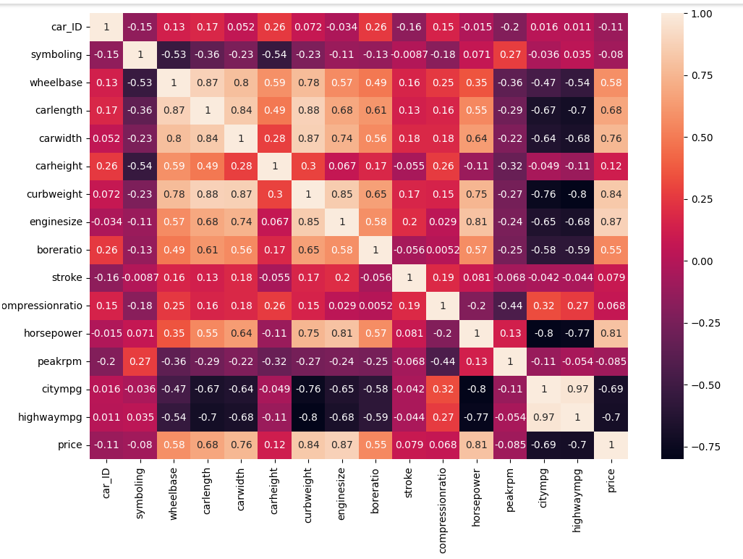
Represent the correlation coefficients between pairs of variables in a dataset.
A correlation heatmap using Seaborn sns. heatmap() is a suitable choice to visually represent the correlation coefficients between pairs of variables in a dataset
By examining the heatmap, we can quickly see which variables are positively or negative correlated.

Slide 19
MACHINE LEARNING MODELS
We have utilized the following models in our project for data analysis and decision-making:
Linear Regression
Support Vector Machine(SVM)
Random Forest

Slide 20
LINEAR REGRESSION
Linear regression is a type of supervised machine learning algorithm that computes the linear relationship between the dependent variable and one or more independent features by fitting a linear equation to observed data . The model estimates the probability that a given instance belongs to a particular class using a logistic function.
When there is only one independent feature, it is known as Simple Linear Regression, and when there are more than one feature, it is known as Multiple Linear Regression.
Its simplicity is a virtue, as linear regression is transparent, easy to implement, and serves as a foundational concept for more complex algorithms.

Slide 21
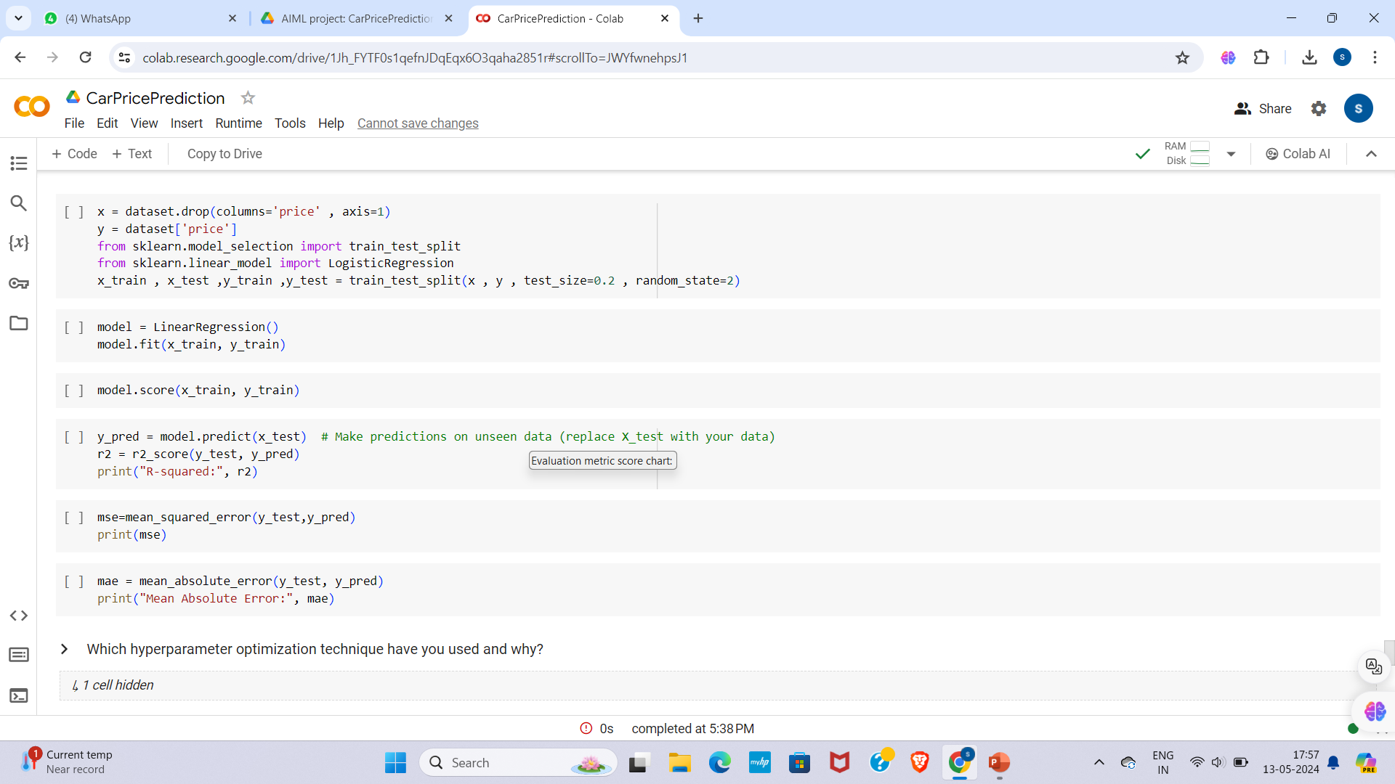
ML MODEL IMPLEMENTATION

Slide 22
SUPPORT VECTOR MACHINE
A support vector machine (SVM) is a supervised machine learning algorithm that classifies data by finding an optimal line or hyperplane that maximizes the distance between each class in an N-dimensional space
SVMs are adaptable and efficient in a variety of applications because they can manage high-dimensional data and nonlinear relationships.
Support vector regression (SVR) is an extension of SVMs, which is applied to regression problems (i.e. the outcome is continuous). Similar to linear SVMs, SVR finds a hyperplane with the maximum margin between data points, and it is typically used for time series prediction.

Slide 23
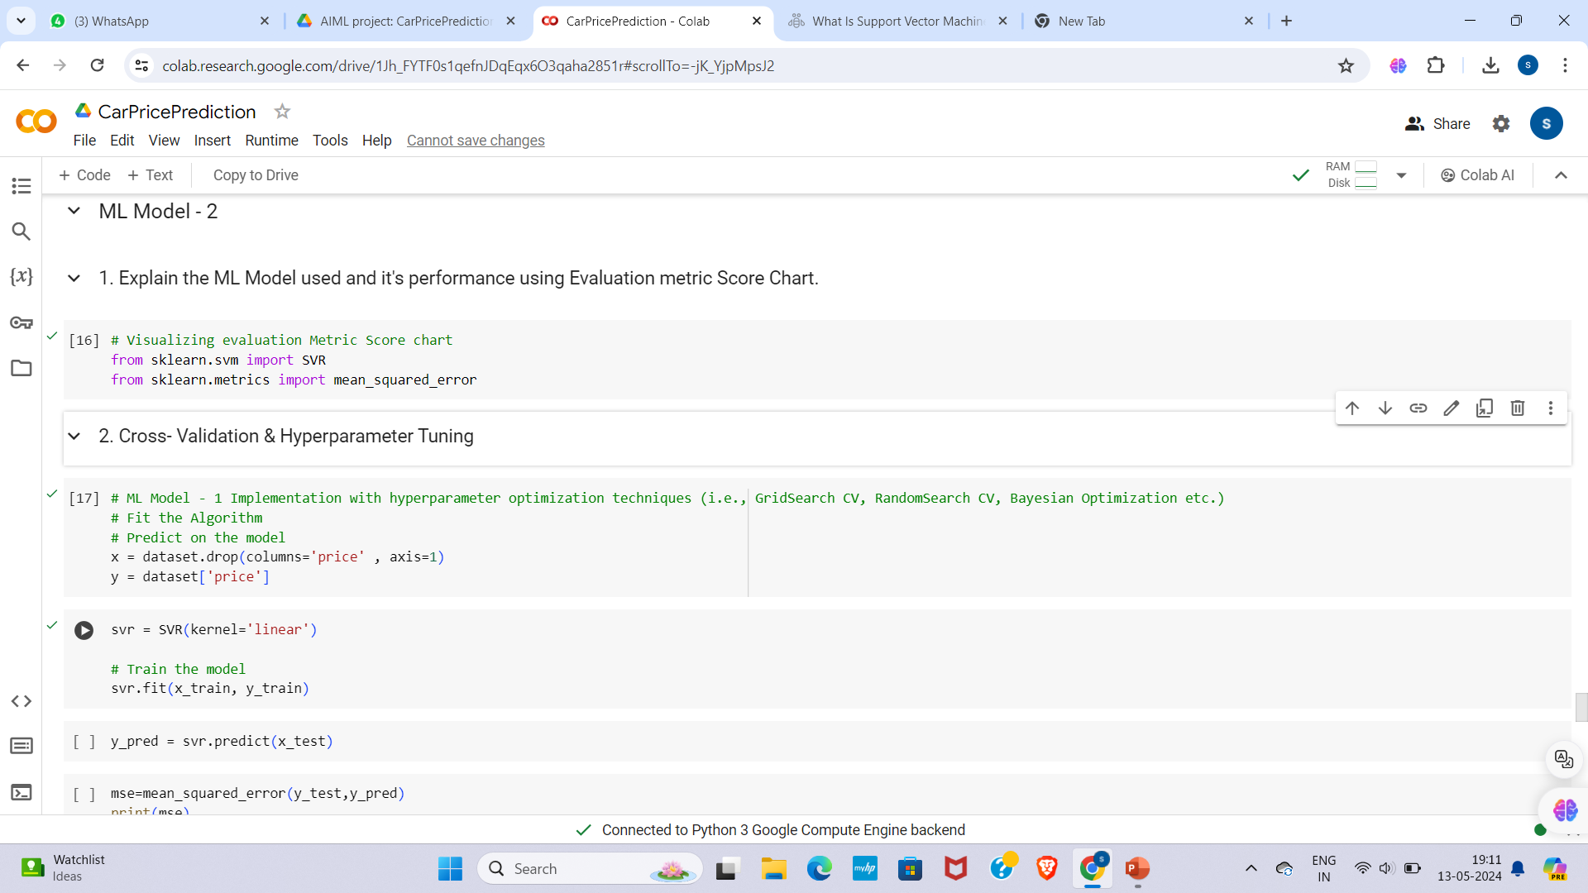
ML MODEL IMPLEMENTATION

Slide 24
RANDOM FOREST
Random forest is an ensemble learning method that builds multiple decision trees during training.
Each tree is constructed using a random subset of the features and a random subset of the training data.
The final prediction is made by averaging the predictions of all trees (for regression) or by taking a majority vote (for classification).
Random forest improves upon decision trees by reducing overfitting and increasing robustness, making it suitable for a wide range of tasks.

Slide 25
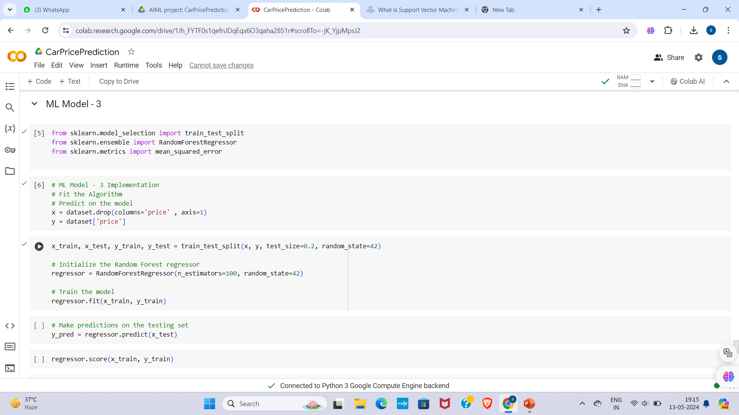
ML MODEL IMPLEMENTATION

Slide 26
Challenges
Obtaining clean and reliable data can be challenging, especially when dealing with large datasets from multiple sources
Issues such as missing values, outliers, and inconsistencies can affect the accuracy of the prediction model
Car prices are influenced by market trends, economic conditions, and seasonality, making it crucial to account for temporal dynamics in the prediction model.
The relationship between car features and prices may be nonlinear and complex.

Slide 27
Recommendations
Explore additional features that could potentially improve the model's predictive power. This could include factors like vehicle history reports, accident records, maintenance history, or market trends.
Ensure data cleanliness and accuracy by conducting thorough data cleaning and preprocessing steps. Remove outliers, handle missing values appropriately, and address any inconsistencies in the dataset.
Experiment with different machine learning algorithms and hyperparameter settings to identify the most effective model for car price prediction.
Explore ensemble learning techniques, such as random forests or gradient boosting, to combine the strengths of multiple models and improve prediction accuracy.
Collaborate with industry experts, car dealerships, or automotive analysts to gain insights into factors driving car prices and validate model predictions against real-world market observations.

Slide 28
Conclusions
Concluding a car price prediction project involves summarizing the findings, evaluating the model's performance, and suggesting potential areas for improvement or future research
summarizing the main findings of your car price prediction project. Highlight the key insights gained from the analysis and model development process.
Evaluate the performance of the car price prediction model. Discuss metrics such as accuracy, precision, recall, and F1-score (if applicable).
Discuss the most influential factors identified during the analysis. This could include variables such as make, model, year, mileage, condition, location, and features.
Acknowledge the limitations of the study. This could include data limitations, model assumptions, or constraints that may have impacted the accuracy or generalizability of the results.
Suggest potential avenues for future research or improvements to the car price prediction model.
Summarize the main takeaways from the project and reiterate its significance. Emphasize the value of accurate price prediction in the automotive industry and the potential benefits of further research in this area.

